Slide 1
BAN 210 – FINAL PROJECT AUTO MPG DATASET
By-
Roshan Nair
(134526219)

Slide 2
GOAL OF THE ANALYSIS
To predict value of our target variable.
To check which model is performing better and by how much accuracy.

Slide 3
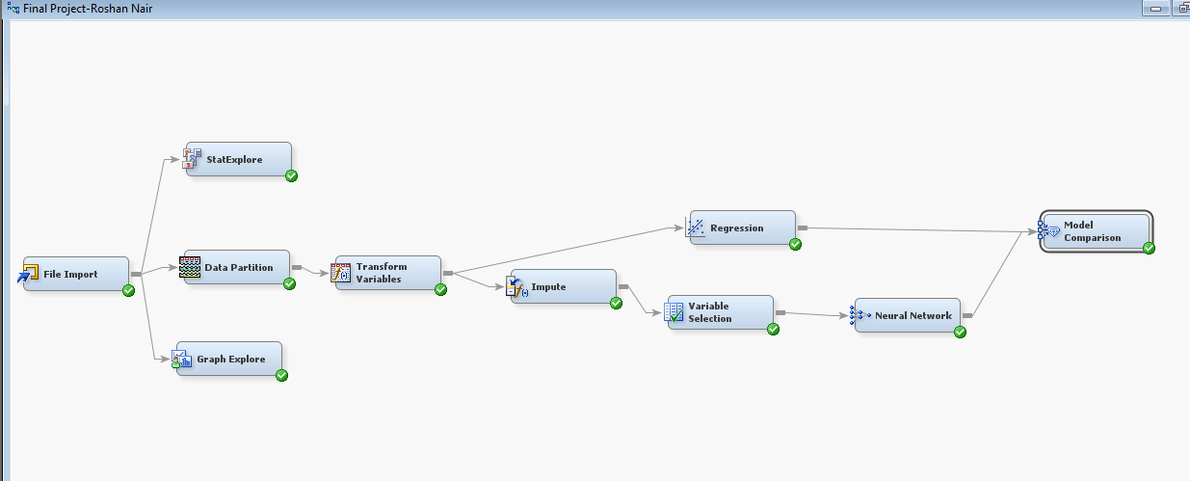
STEPS IN THE SAS MINER
The below steps/nodes
have been used for the analysis:
Step 1: File Import
Step 2: Stat Explore
Step 3: Graph Explore
Step 4: Data Partition
Step 5: Data Transformation
Step 6: Imputation
Step 7: Regression Model
Step 8: Variable Selection
Step 9: Neural Network
Step 10: Model Comparison

Slide 4
DATA DESCRIPTION
The data concerns city-cycle fuel consumption in miles per gallon, to be predicted in terms of 3 multivalued discrete and 5 continuous attributes.
Attribute Information:
1. mpg: continuous (TARGET VARIABLE)
2. cylinders: multi-valued discrete
3. displacement: continuous
4. horsepower: continuous
5. weight: continuous
6. acceleration: continuous
7. model year: multi-valued discrete
8. origin: multi-valued discrete
9. car name: string (unique for each instance)

Slide 5
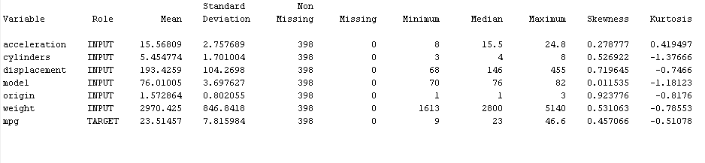
DATA DESCRIPTION

Slide 6
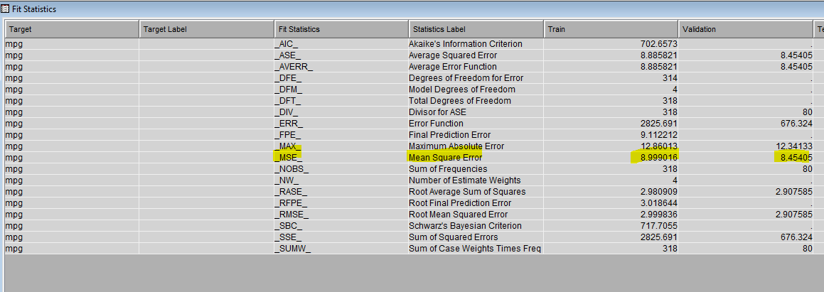
LINEAR REGRESSION MODEL
MSE = 8.45

Slide 7
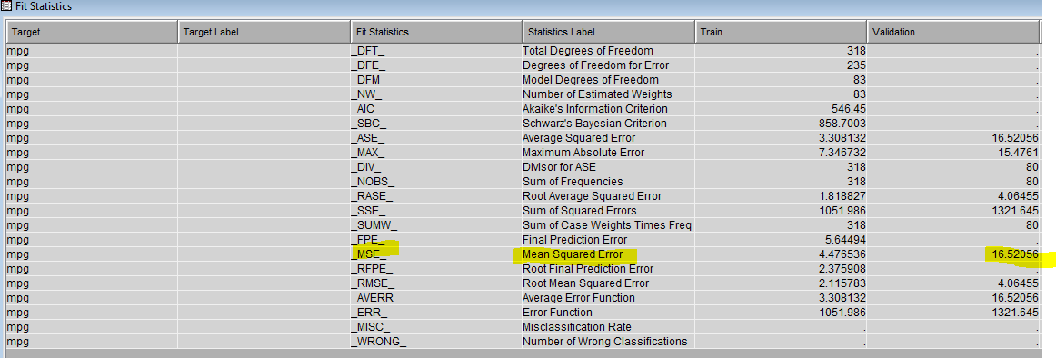
NEURAL NETWORK MODEL
MSE = 16.52

Slide 8
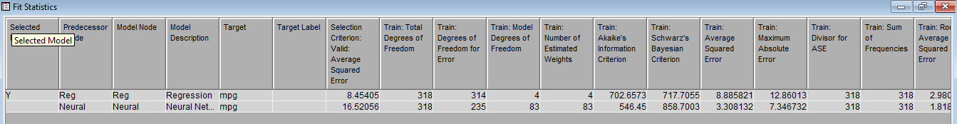
COMPARING MODELS
I compared the two models inferring Mean Squared Error (MSE). Linear Regression model (MSE-8.45) is better than the Neural Network model, as the MSE Score is lower as compared to the Neural Network model (MSE-16.52) and hence it gives us the best prediction value of our target variable.

Slide 9
THANK YOU!

